Slide 1
Secure SimpleDB
Final Presentation, Special topics on DB (2015 spring)
Database Encryption
Multi-user SimpleDB with access control
Web UI for SimpleDB

Slide 2
Database Encryption

Slide 3
Contents
Motivation
Example query execution
Structure

Slide 4
Contents
Motivation
Example query execution
Structure

Slide 5
Motivation
Database security
Data should be illegible to adversary
Only authorized parties can read the data

Slide 6
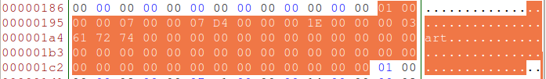

Example
Raw file – STUDENT.tbl
(7, 'art‘, 30, 2004) (8, 'pat', 20, 2001)

Slide 7
Example
00 00 00 07
SID – 7
00 00 07 D4
Year - 2004
00 00 00 1E
Majorid - 30
00 00 00 03 61 72 74
Sname - art
00 00 00 08
SID-8
00 00 07 D1
Year - 2001
00 00 00 14
Majorid - 20
00 00 00 03 70 61 74
Sname - pat

Slide 8
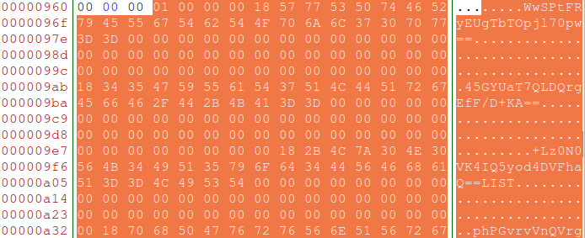
Example
Encrypted raw file – STUDENT.tbl
(7, 'art', 30, 2004) (8, 'pat', 20, 2001)

Slide 9
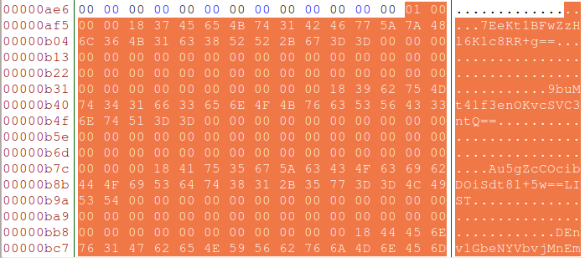
Example

Slide 10
Motivation
Database raw file should be encrypted!

Slide 11
Contents
Motivation
Query execution example
Structure

Slide 12
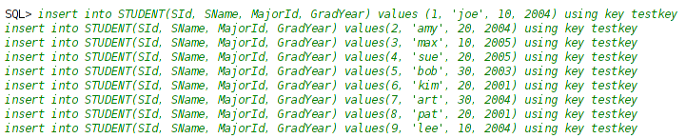
Example Table

Slide 13
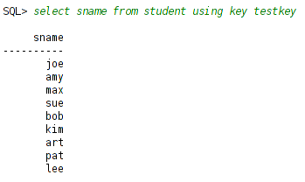
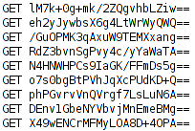
Example – Select Query
Client-side
Server-side
(before decrypt)

Slide 14
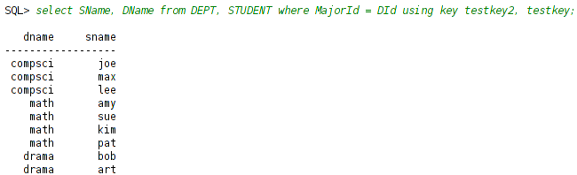
Example – Select Query2
Different key between two tables

Slide 15
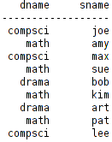
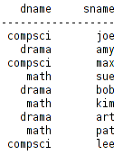
Example – Modify query

Slide 16

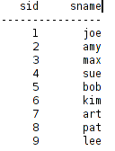
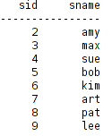
Example – Delete query

Slide 17
Contents
Motivation
Example query execution
Structure

Slide 18
Structure
Client
Server
Remote
Encryption
Planner
Record
Metadata
Parser
Query
Transaction
Buffer
Log
File

Slide 19
Structure - Parser
Encrypt Metadata
Encrypted Table Name
Encrypted Table Field Type
Field type list of the table
Key Manager
Temporary key storage

Slide 20
Structure - Parser
Parser
Encryption
Encrypt Metadata
Key Manager
Encrypted Table Name
Field Type

Slide 21
Structure - Planner
Update Planner
Create Table
Create encrypted table list
Create cipher-text table
Field Type table
Every cipher-text is varchar
Length of cipher-text is different from length of plain-text
Insert, Modify, Delete
Operate these queries after get a key from key manager and encrypt/decrypt data
Query Planner
Encrypt Table Plan
If Table name is existed in Encrypted table list, then create Encrypt table plan

Slide 22
Structure - Planner
Parser
Encryption
Planner
Query Planner
Update Planner
Create Table
Insert, Modify, Delete
Encrypted Table List
Field Type Table

Slide 23
Structure - Query
Create Encrypted table plan
Encrypted table info (name, type, length)
Get table info from field type table
Create Encrypted table scan
Table scan with encryption key

Slide 24
Structure - Query
Parser
Encryption
Planner
Query
Field Type Table
Encrypted Table Plan
Key Manager
Encrypted Table Scan

Slide 25
Structure - Encryption
Create Pseudo random key
Pseudo-random function is based on md5 encrypt hash

Slide 26
Structure - Encryption
Plain text
Key
Pseudo Random Function
Encrypt Function
Decrypt Function

Slide 27
Multi-user with access control

Slide 28
Overview
New
Modified
Client
Server
WebServer
with WebUI
Remote
Planner
Record
Metadata
Parser
Metadata Manager
Table manager
View manager
Index manager
Stat manager
SECURITY MANAGER
Query
Transaction
Buffer
Log
File

Slide 29
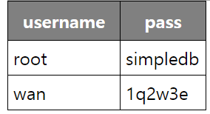
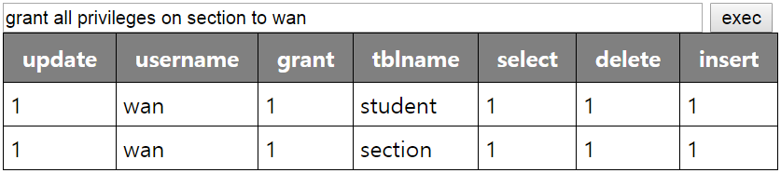
Data structure
User data management
Using table usrcat
Privilege management
Using table privcat

Slide 30
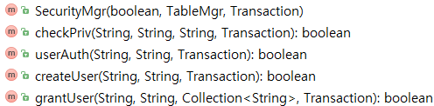
Authentication
Multi-user DBMS needs
Identification
Authentication
To implement multi-user SimpleDB
Modified Remote
Make user management methods

Slide 31

How to auth
User request authentication by using this
RemoteDriver make a new transaction
Check id, pw by using the transacation
Give Connection or throw exception

Slide 32
Access control concept
Concept of Access control
Security Manager
A new feature in Secure SimpleDB
Reference monitor
User management
Privilege management
Client
(Access request)
Reference
Monitor
(Access control)
Server
(Storage)

Slide 33
New methods
Security manager

Slide 34
How to do “access control”
executeQuery
Read tables using a lexer
Do checkpriv(“select”, username, tablename) recursively in a parser
Execute the query or throw Exception(“access denied”)

Slide 35
How to do “access control”
executeUpdate
Parse SQL and make query data
Read operation from the query data in planner
Read tables from the query data in planner
Do checkpriv(operation, username, tablename)
Execute the query or throw Exception(“access denied”)

Slide 36
Modified features
Lexer
Add some keyword
grant, on, identified, to, by, user & etc.
Parser
Add ‘grant’

Slide 37
WebUI

Slide 38
New features
Web Server
Use jetty, web server.
Started with SimpleDB
DatabaseMetaData
Used to get information about DBMS
To implement this, following classes are needed
RemoteDatabaseMetaData
SimpleDatabaseMetaData
DatabaseMetaDataAdapter

Slide 39
Modified features
RemoteConnection
To maintain user identification
RemoteStatement
To execute query with user identification
Driver
Connection
Statement
Resultset

Slide 40
Orgranization
Index.jsp
UI : To auth user
UI.jsp
UI: Manage authenticated session
SQLexec.jsp
Module: Execute the query
GetTables.jsp
Module: Get list of tables to display in UI.jsp

Slide 41
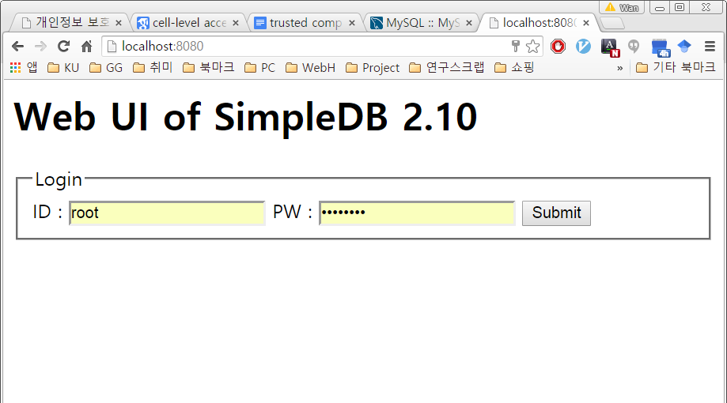
Web UI - Captures

Slide 42
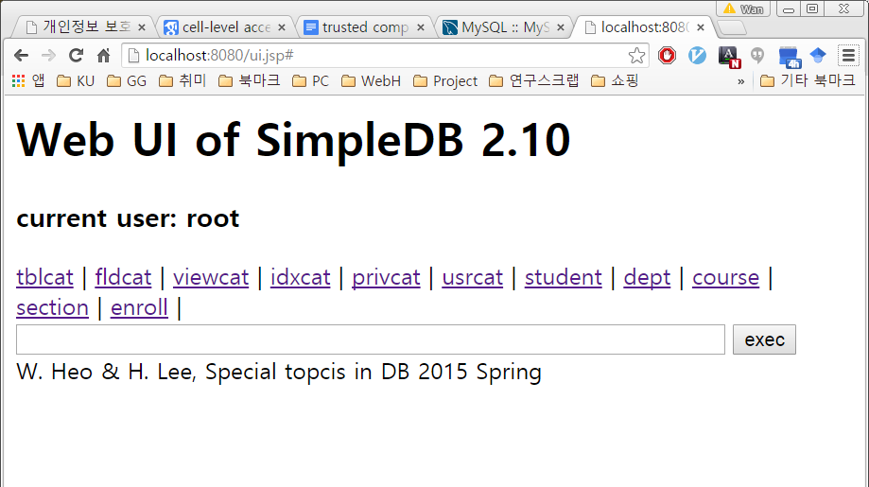
Web UI - Captures

Slide 43
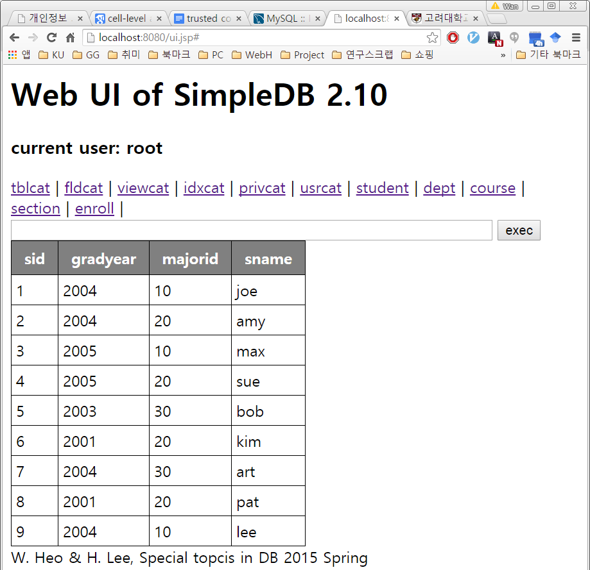
Web UI - Captures

Slide 44
QnA

Slide 45
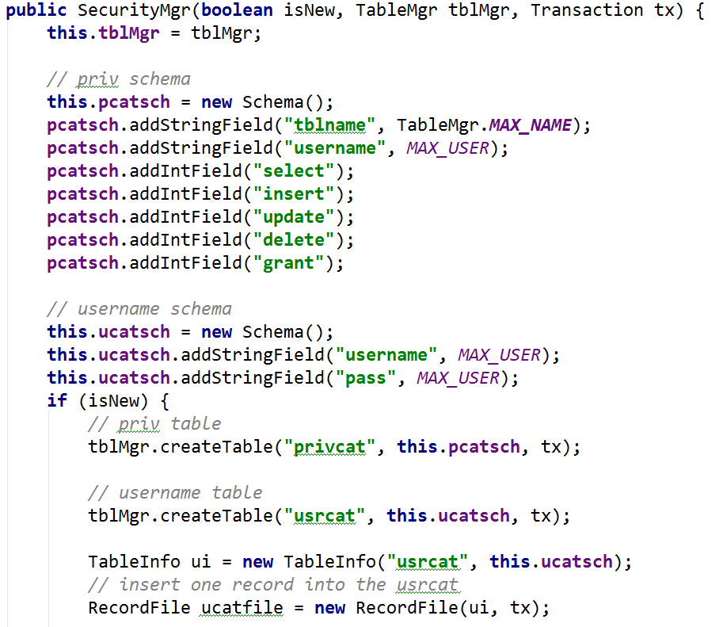
SecurityMgr - Code

Slide 46
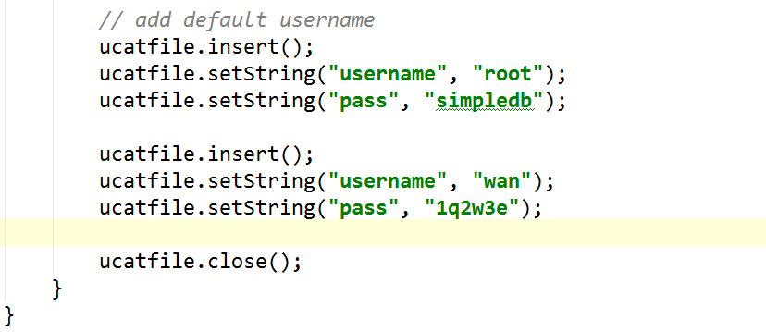
SecurityMgr - Code

Slide 47
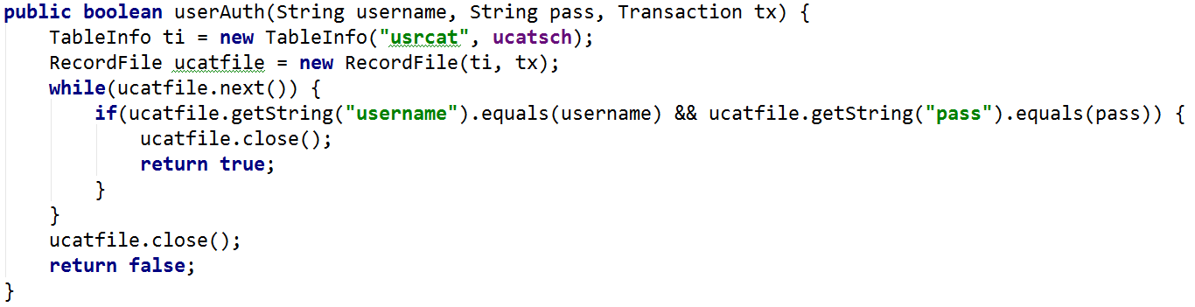
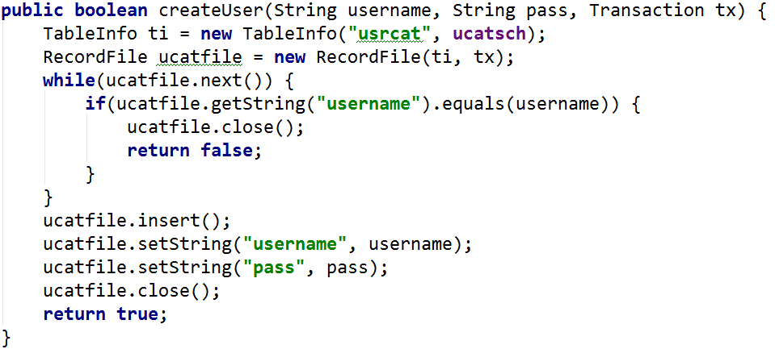
SecurityMgr - Code

Slide 48
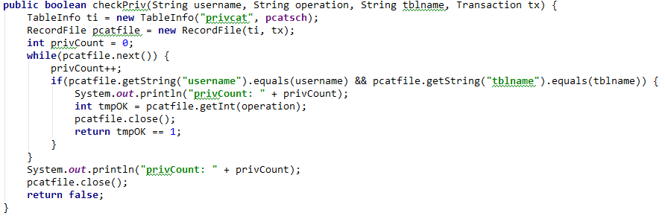
SecurityMgr - Code

Slide 49
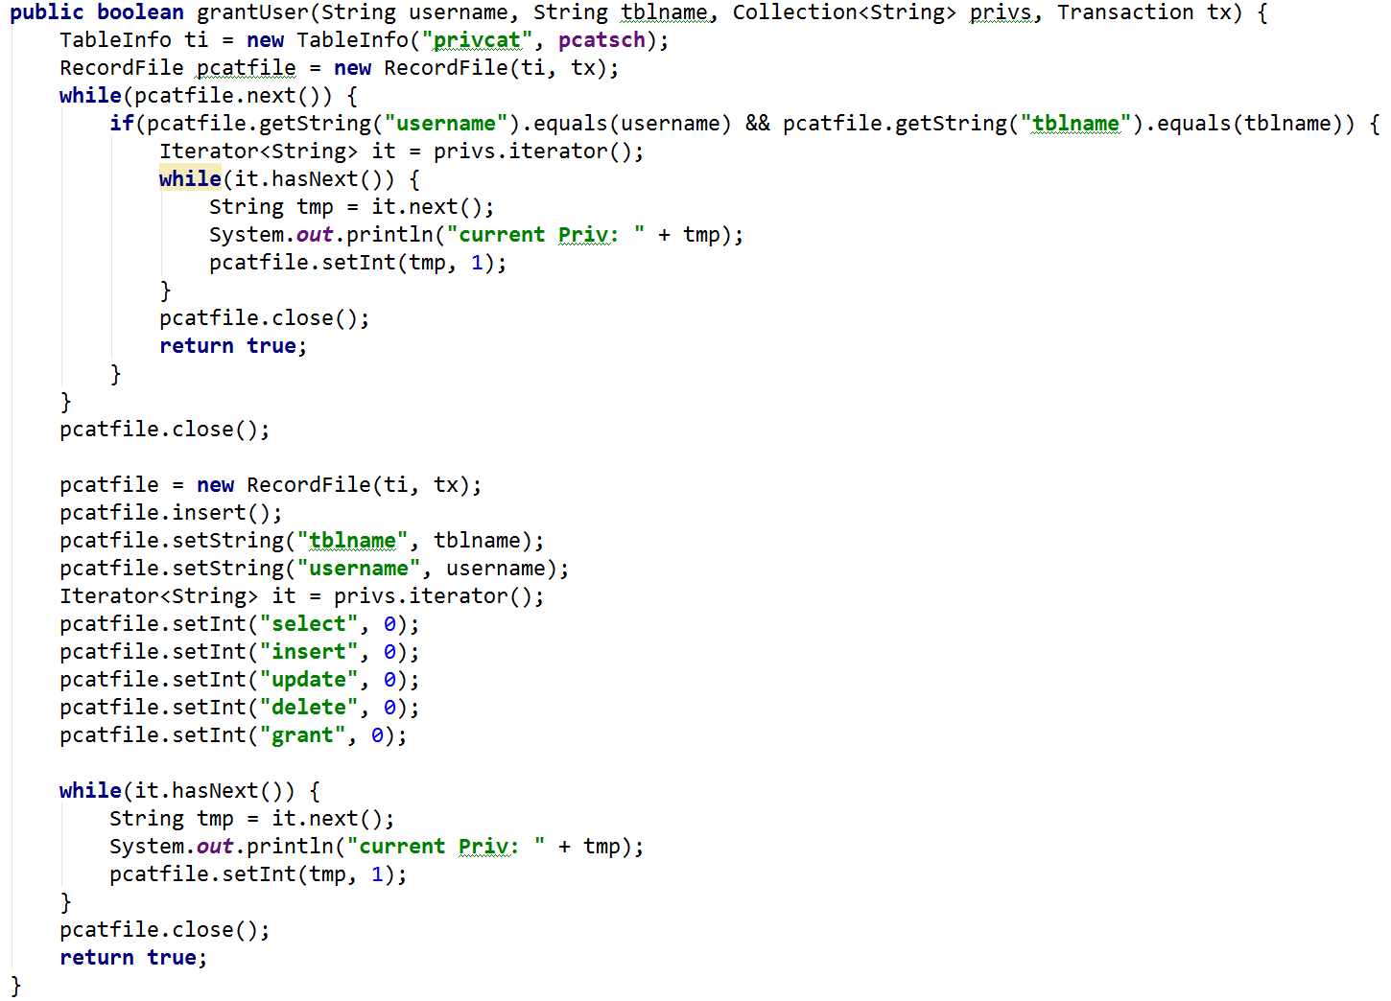
SecurityMgr - Code

Slide 50
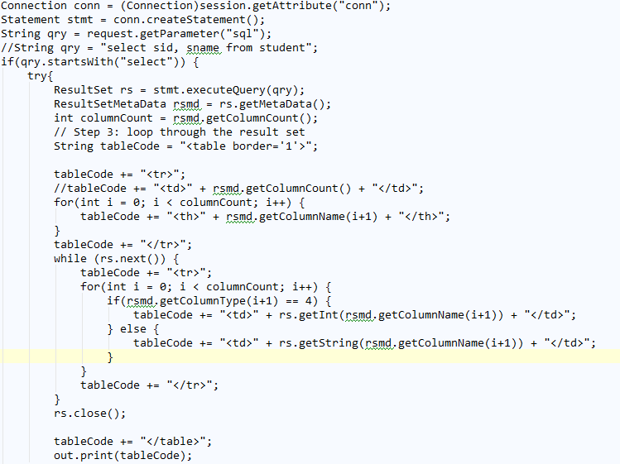
Web UI - Code

Slide 51
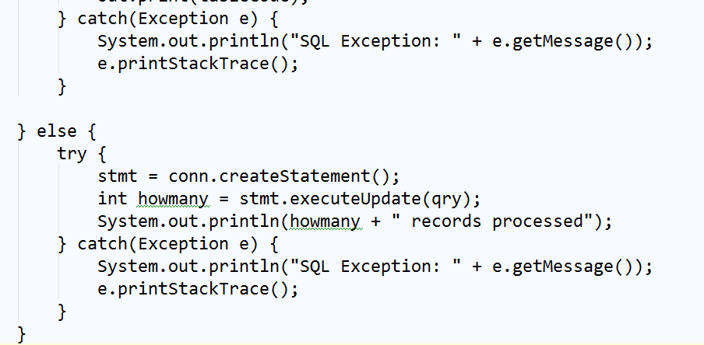
Web UI - Code

